Slide 1



Vijaya Jothi POWER BI NETFLIX
View in Power BI
Last data refresh:
05/05/2024 02:59:39 UTC
Downloaded at:
06/05/2024 15:10:29 UTC

Slide 2
Netflix Data Visualization using Power BI
Prepared by
Vijaya Jothi Vijayarajan
Just IT Data Camp
Data Group – Cohort 10 08-04-2024​​
Data Technician Boot Camp
​​Course Instructor:​ Tamoghna Das
​​Due Date​ 05–05-2024

Slide 3
NUMBER | TIME PERIOD | Year Released
4826 | new | 2011-2021
1073 | 90S | 1991-2010
206 | retro | 1970-1990
50 | classic | 1956-1965
6155

Slide 4
There are 756 Independent Movies in the dataset.
There are 2752 International Movies in the Library.
rating
TV-PG | 34
TV-14 | 155
TV-MA | 34
TV-Y7 | 2
PG | 2
TV-G | 2
R | 1
PG-13 | 1
0
 | 231
 | Indonesia | 83
 | Thailand | 41
 | South Africa | 0
 | Lebanon | 16
 | Chile | 16
 | Vietnam | 7
 | Kuwait | 5
 | poland | 22
 | Portugal | 3
 | Bangladesh | 3
 | Malaysia | 16
 | Ireland | 15
 | Saudi Arabia | 6
 | Taiwan | 13
 | Switzerland | 5
 | Singapore | 10
country | movie
United States | 2338
Germany | 74
Japan | 85
Hong Kong | 76
Brazil | 54
Egypt | 98
Australia | 58
Spain | 127
Unitea Arab Emirates | 0
Italy | 46
South Africa | 0
India | 924
Nigeria | 87
France | 134
Turkey | 80
Denmark | 11
New Zealand | 14
United Kingdom | 349
Mexico | 86
canada | 182
Hungary | 5
Austria | 8
Philippines | 76
Argentina | 53
Romania | 9
Netherlands | 19
Russia | 5
China | 57

Slide 5
s4254 | Black Mirror: Bandersnatch | 28-Dec-18 | 2018 | TV-MA | 312 min | Dramas, International Movies, Sci-Fi & Fantasy
Serbia | 3
Finland | 2
Poland | 22
Sweden | 10
Thailand | 41
Russia | 5
Romania | 9
Ireland | 15
Portugal | 3
Bulgaria | 4
Czech Republic | 5
Namibia | 1
Georgia | 2
West Germany | 1
Soviet Union | 1
Cameroon | 1
Iran | 1
Jamaica | 1
Paraguay | 1
Greece | 1
Mozambique | 1
Zimbabwe | 1
South korea | 47
Pakistan | 18
Kenya | 4
Cambodia | 2
Colombia | 15
Mauritius | 1
Belgium | 8
Ghana | 4
Uruguay | 7
Norway | 10
Peru | 6
Venezuela | 2
Guatemala | 1
Iceland | 3
s1485 | Cops and Robbers | 28-Dec-20 | 2020 | PG-13 | 8 min | Dramas

Slide 6
1. Firstly, I removed the Empty columns 2. Then I Removed a few outlier rows of movie data that had errors or were missing
3. Split the Table into two additional tables, one on movies and one on TV. (Original table was kept too.) 5. Removed descriptions. 6. Cut down cast, director, and countiry fields to only their first listed member for clarity, as well as a secondary lead from the cast.
Transformation Steps
Transformation Steps

Slide 7
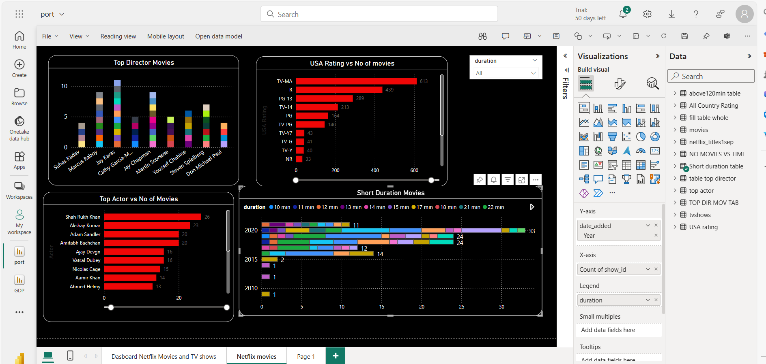

Slide 8
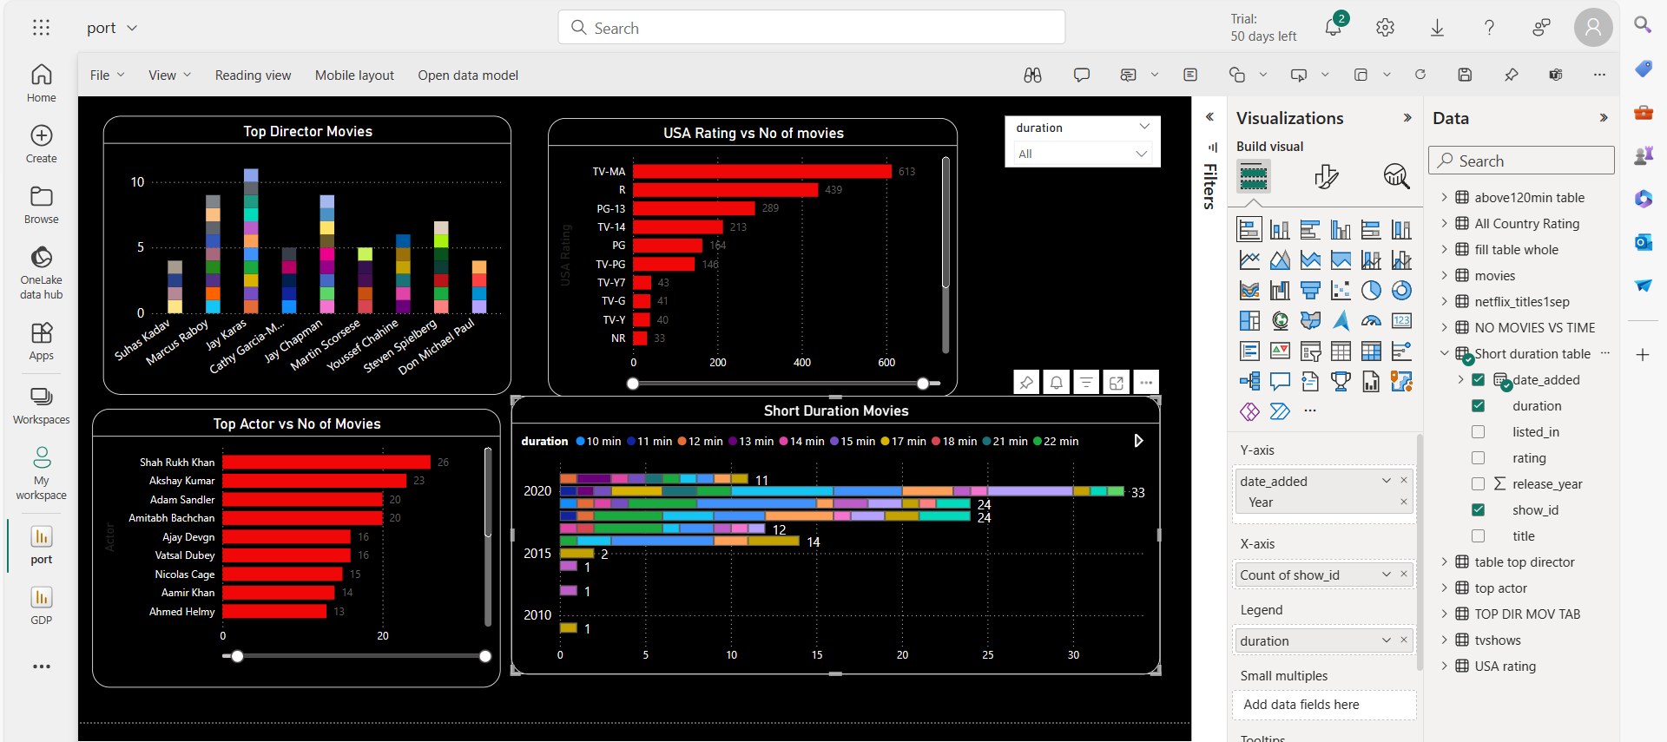

Slide 9
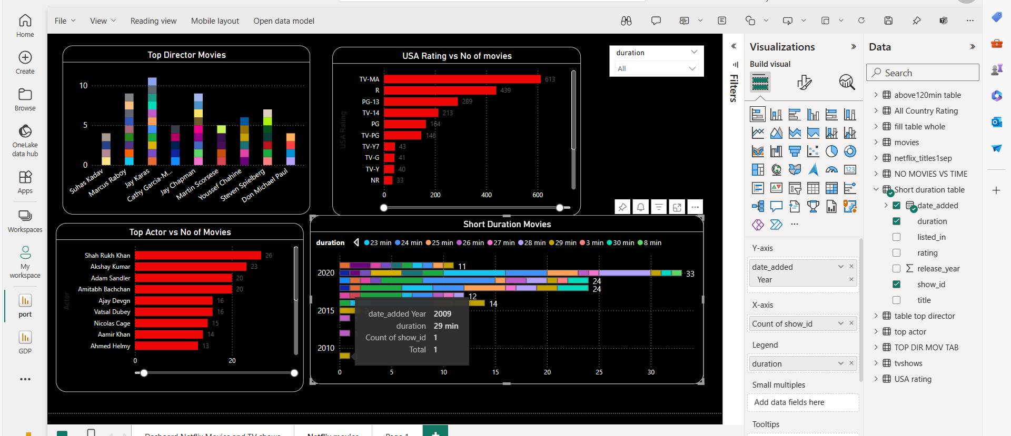

Slide 10
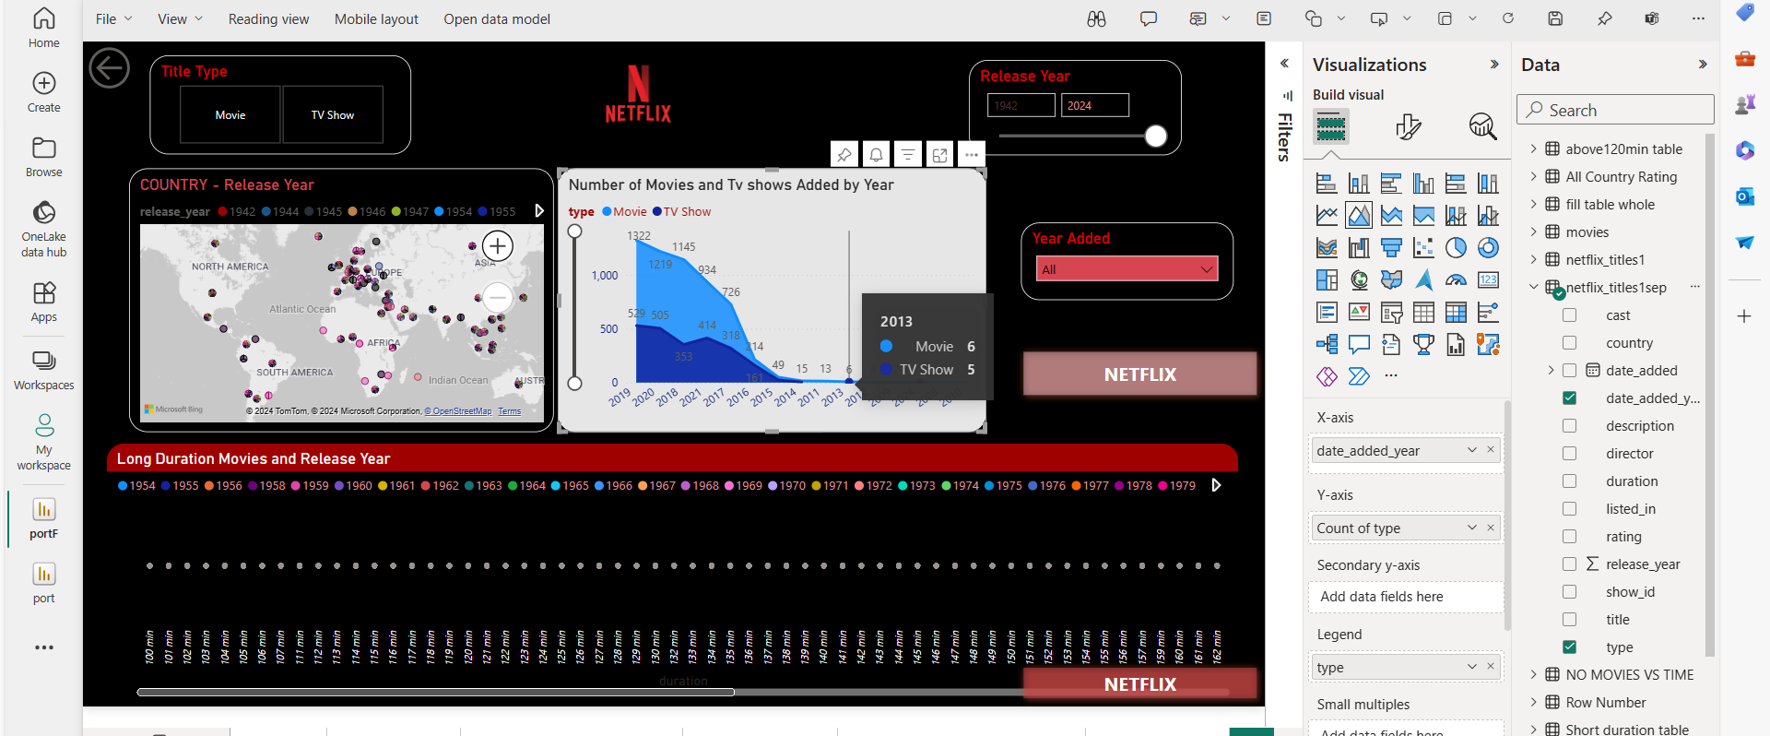
Next
Studio
Production Company (distributor)
Production Company (producer)
Director (usually as “A ‘Director’ Film”)
FILM TITLE
Main Cast
Supporting Cast
Casting Director
Composer
Costume Designer
Associate Producer(s)
Editor
Production Designer
Cinematographer
Executive Producer
Producer
Writer(s)
Director (Second reference)

Slide 11
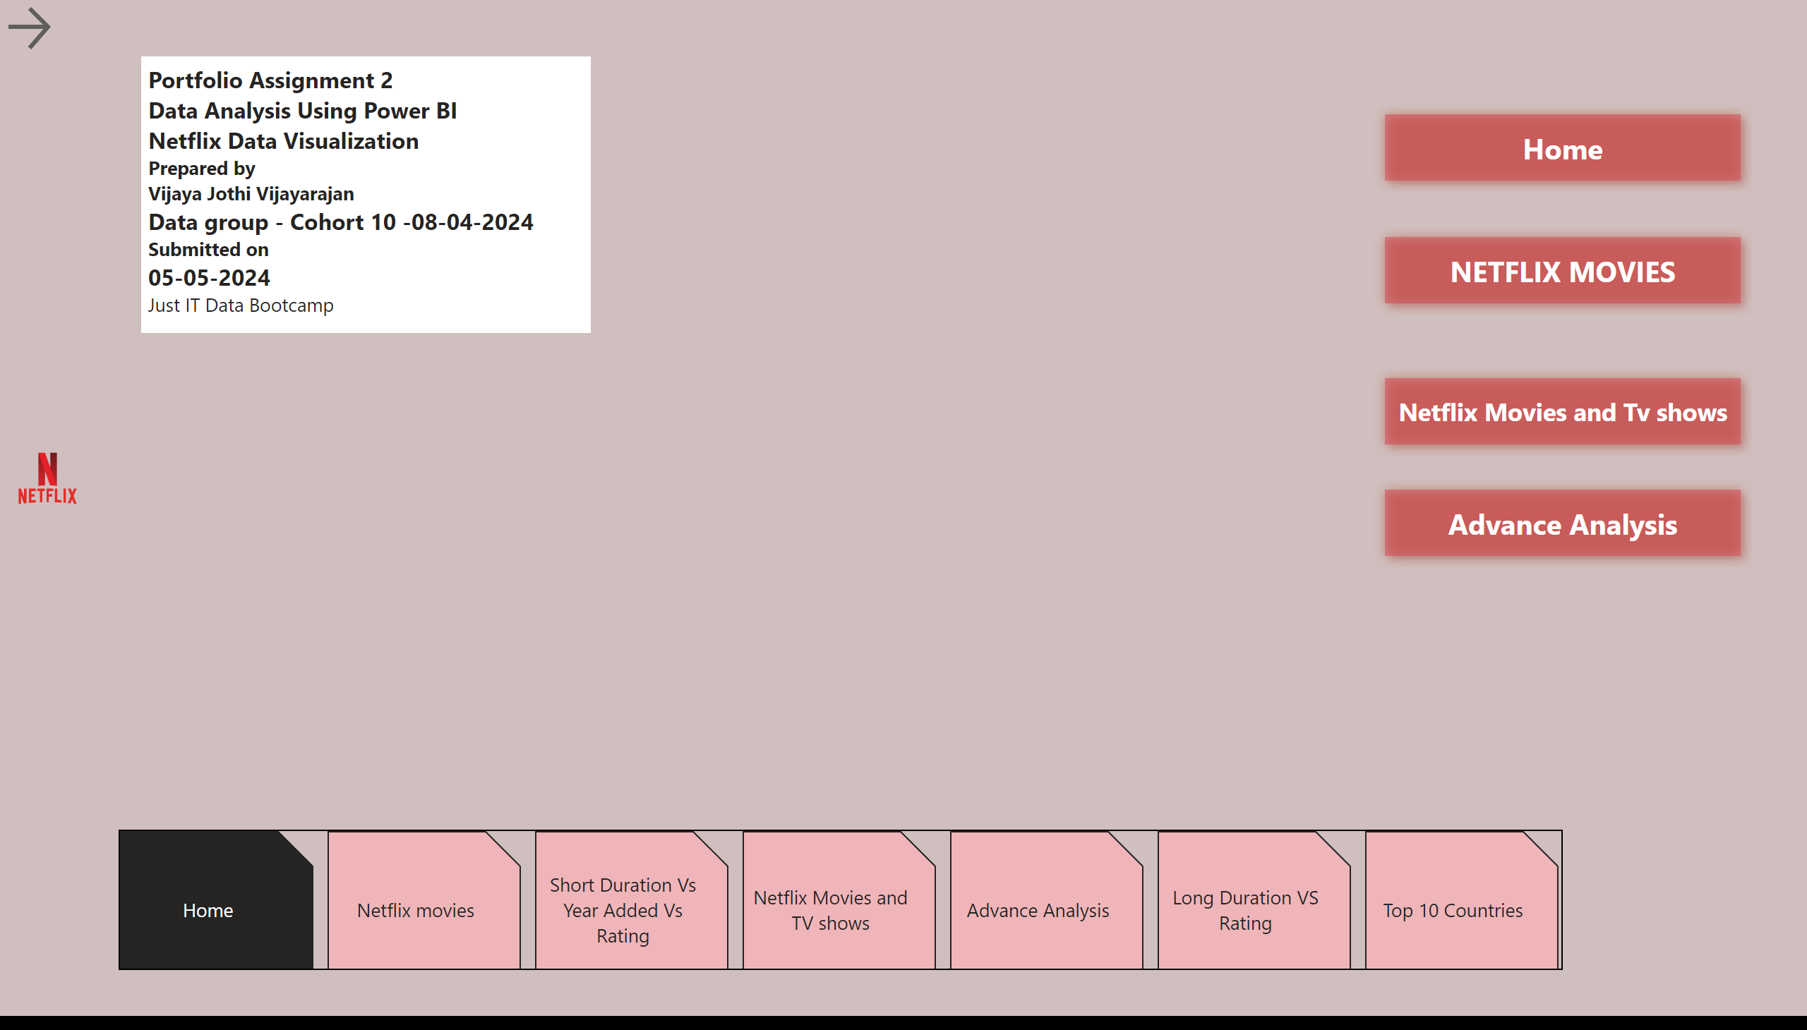
Home
Notes:
image
No alt text provided
actionButton
No alt text provided
pageNavigator
No alt text provided
actionButton
No alt text provided
actionButton
No alt text provided
actionButton
No alt text provided
actionButton
No alt text provided
textbox
No alt text provided

Slide 12
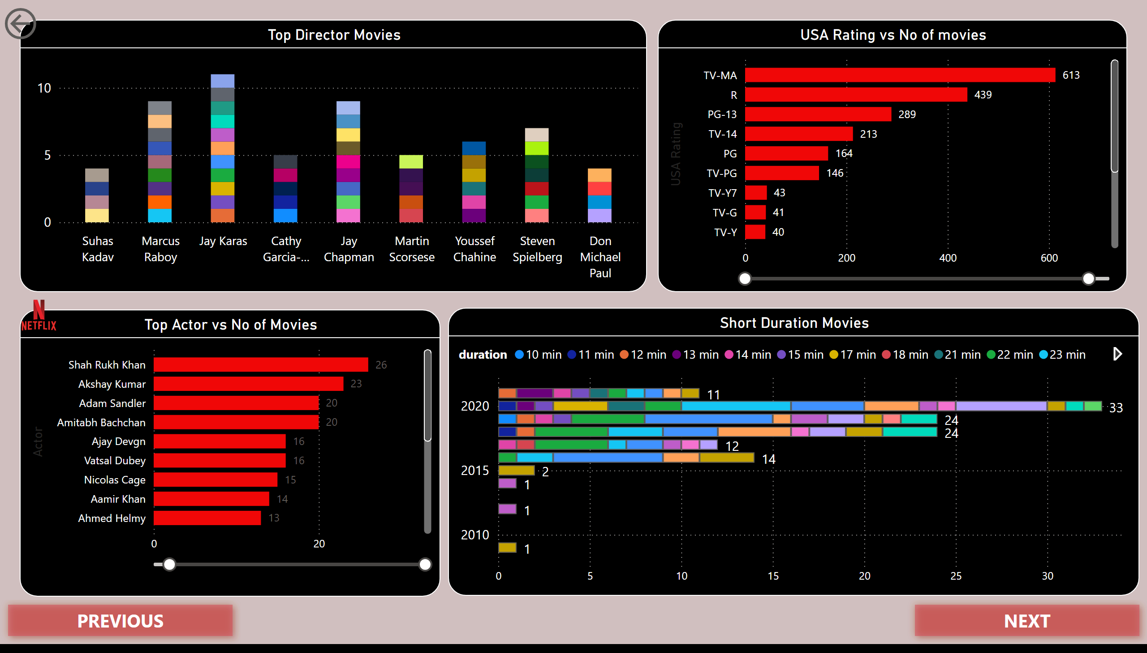
Netflix movies
Notes:
Top Director Movies
No alt text provided
Top Actor vs No of Movies
No alt text provided
USA Rating vs No of movies
No alt text provided
Short Duration Movies
No alt text provided
actionButton
No alt text provided
actionButton
No alt text provided
image
No alt text provided
actionButton
No alt text provided

Slide 13
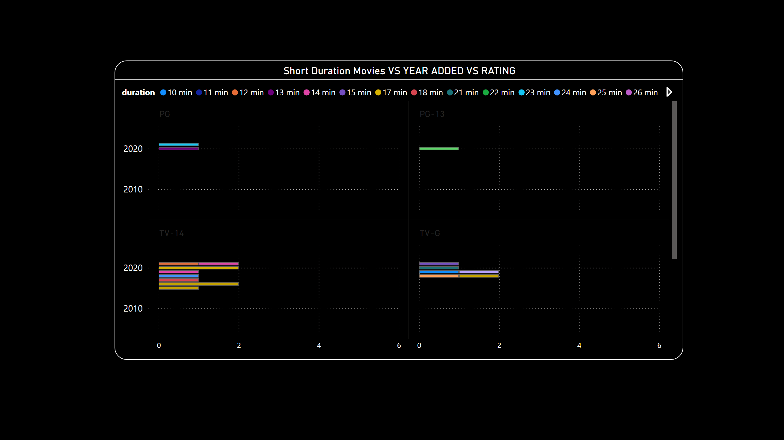
Short Duration Vs Year Added Vs Rating
Notes:
Short Duration Movies VS YEAR ADDED VS RATING
No alt text provided

Slide 14
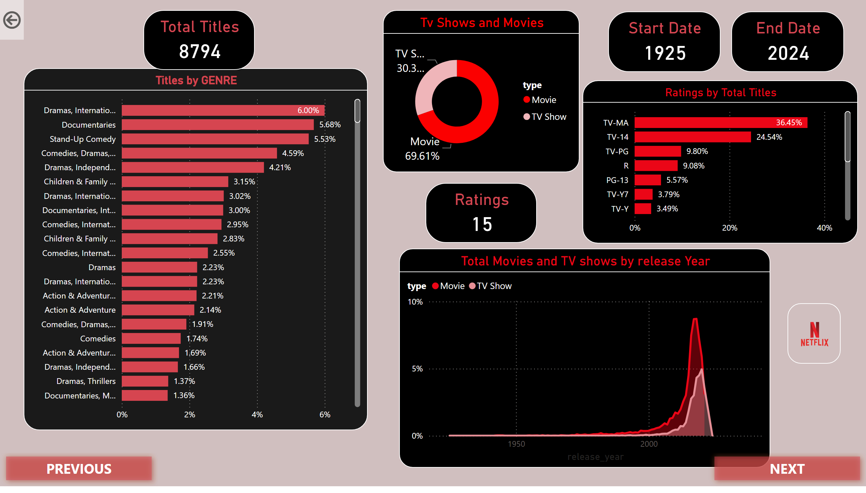
Netflix Movies and TV shows
Notes:
Tv Shows and Movies
No alt text provided
Ratings by Total Titles
No alt text provided
Titles by GENRE
No alt text provided
Total Movies and TV shows by release Year
No alt text provided
image
No alt text provided
Total Titles
No alt text provided
Ratings
No alt text provided
Start Date
No alt text provided
End Date
No alt text provided
actionButton
No alt text provided
actionButton
No alt text provided
actionButton
No alt text provided

Slide 15
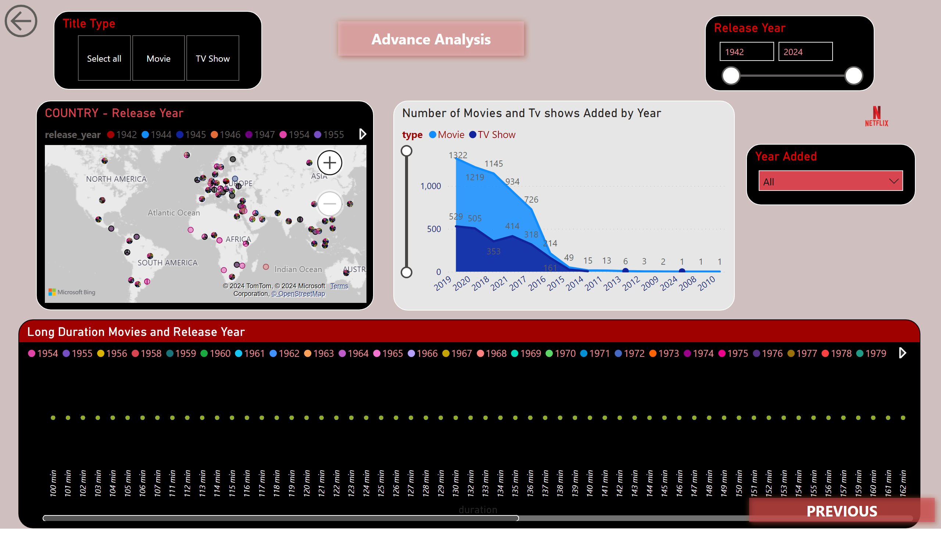
Advance Analysis
Notes:
Title Type
No alt text provided
image
No alt text provided
COUNTRY - Release Year
No alt text provided
Release Year
No alt text provided
Year Added
No alt text provided
Long Duration Movies and Release Year
No alt text provided
Number of Movies and Tv shows Added by Year
No alt text provided
actionButton
No alt text provided
actionButton
No alt text provided
actionButton
No alt text provided

Slide 16
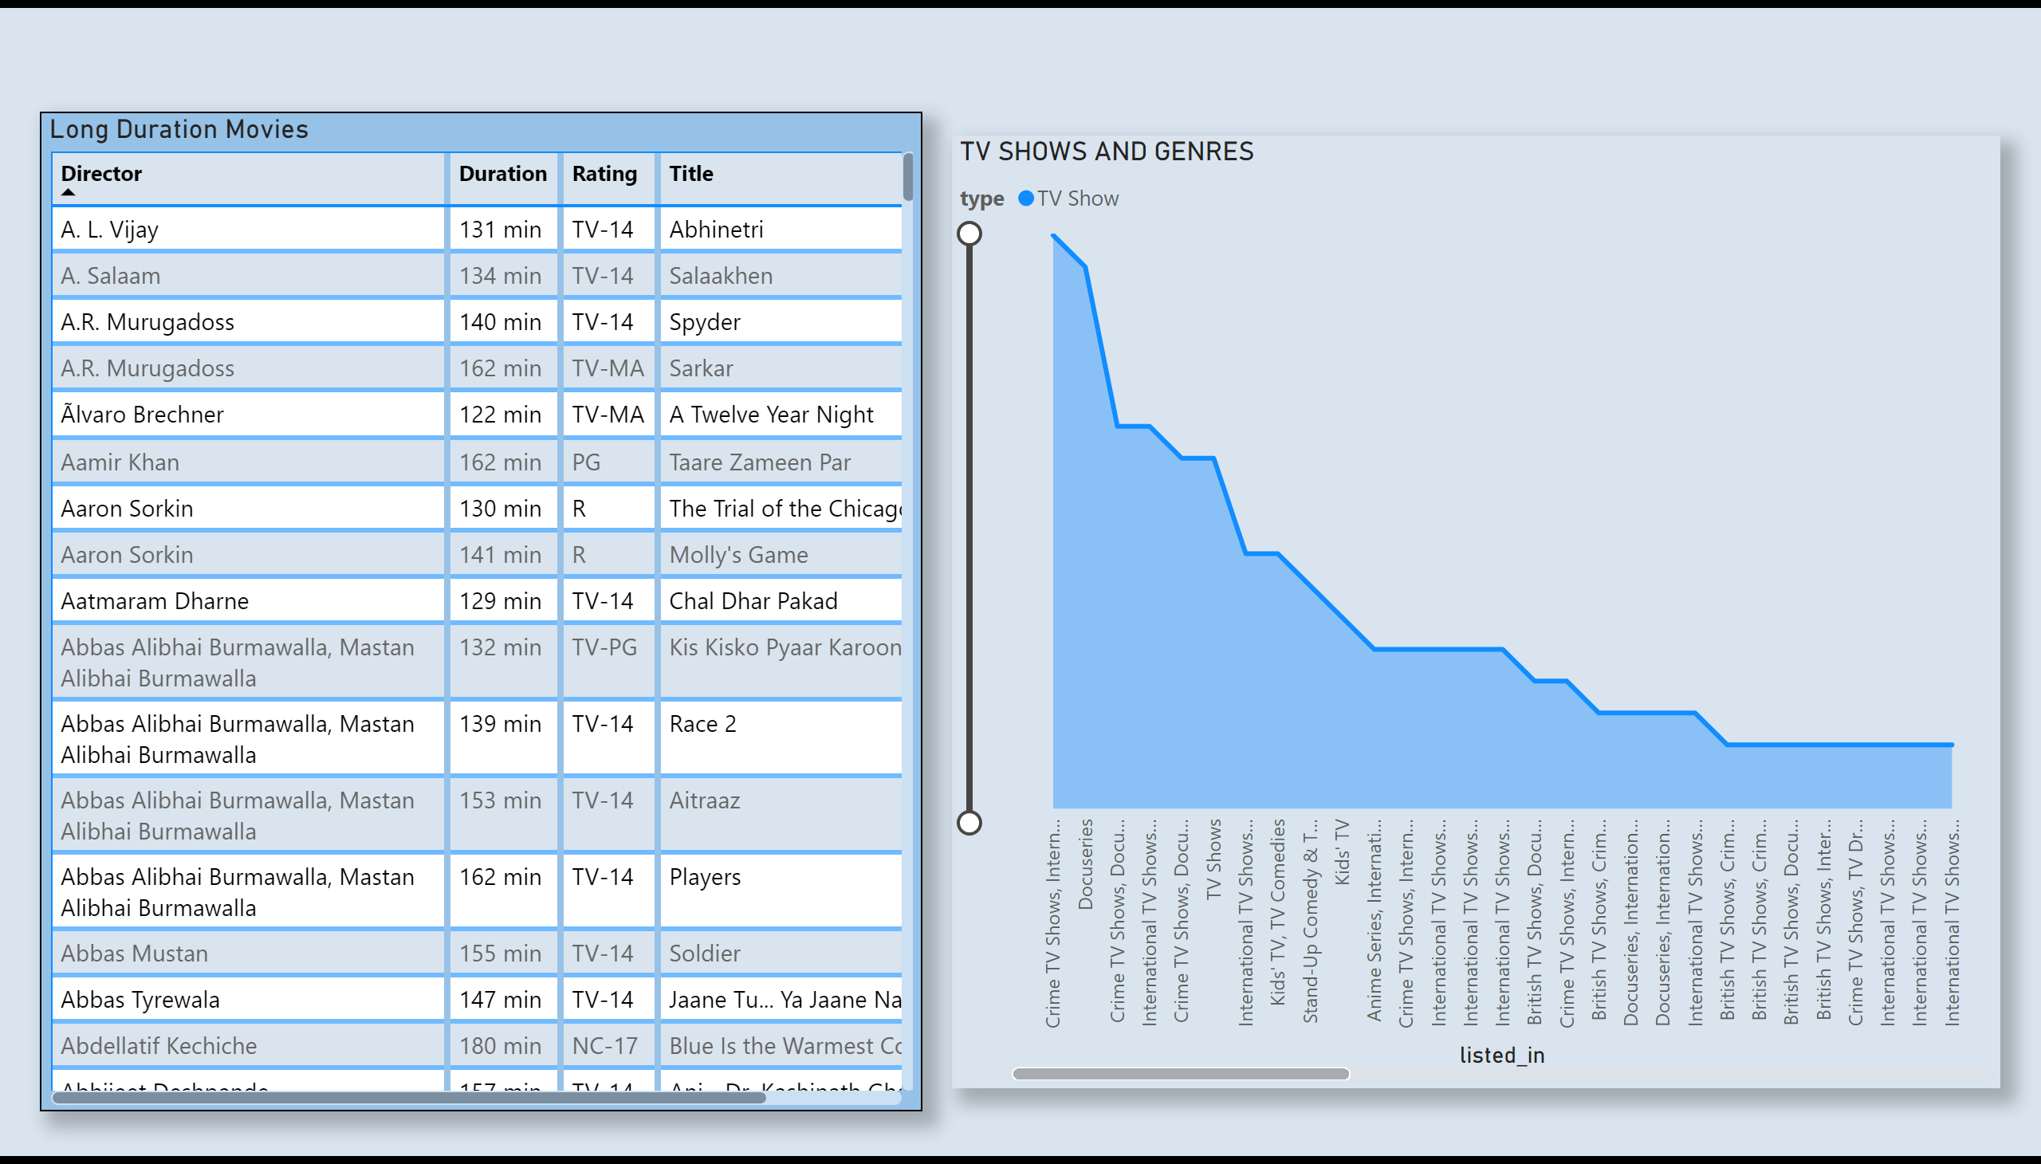
Long Duration VS Rating
Notes:
TV SHOWS AND GENRES
No alt text provided
Long Duration Movies
No alt text provided

Slide 17
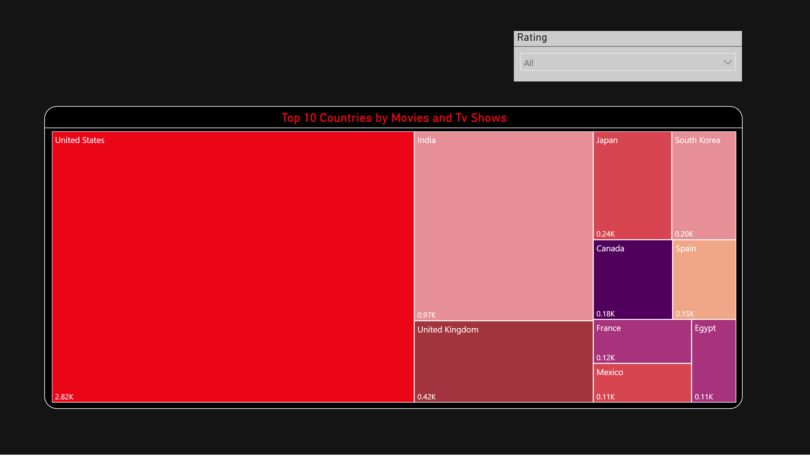
Top 10 Countries
Notes:
Top 10 Countries by Movies and Tv Shows
No alt text provided
Rating
No alt text provided

Slide 18
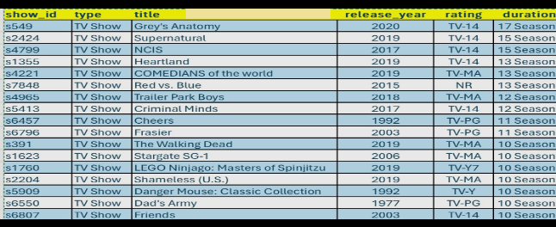
Top Tv Shows
Notes:
card
No alt text provided

Slide 19
thanks

